Slide 1

Notes:
I am back again to introduce my social supermarket, and this time we have a name!
The Social Grocer!!!
The Social Grocer is a social supermarket that aims to elevate food waste while empowering those who need economic assistance.
By being a membership only store for those who prove they do in fact need this assistance.
The Social Grocer takes the surplus from grocery stores and marks them down 70-80%.

Slide 2
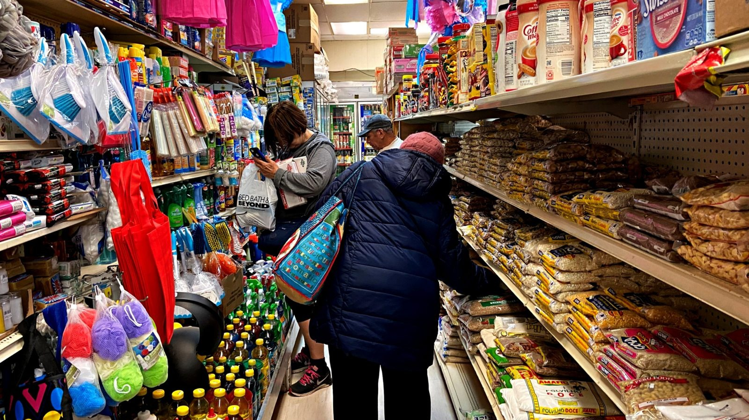
Notes:
A little reminder of who we are
A SSM that offers discounted food exclusively to those in need of econimic assistance.
Part discount grocer, part social service agency, the supermarkets are for members only.
Membership is free, but it is limited to those who can prove they receive some form of welfare benefits/certain income level.

Slide 3
S | W
Alternative option to food stamps | Hard to establish who is in need of these discounts
Helps the 40million people fighting hunger in the US | Relies on the support of grocery-stores/rejection
Uses the surplus food (food waste) and sells it at a large discount | Funding costs/community involvement is key High startup cost
O | T
Educate/empower the members of the SSM through workshops/opportunities for jobs/health | No surplus food given within the community
After the Trump administration's tightened rules on food stamps, more people will use this social supermarket (SSM) Expand into college areas/younger youth to help those fighting bills and hunger Limited competition | Competition from local farmers/groceries & food stamps
SWOT
Notes:
SWOT
Here is a quick overview of my previous SWOT for my beginning phase of The Social Grocer,
As you can see, and if you remember from our Zoom discussions,
One of my original weaknesses was establishing a structured membership plan
as well as the cost of buying the grocerys/getting relationships with grocery stores!
I will explain in future slides some measures I have taken to offset these weaknesses-- don't you worry!

Slide 4

Notes:
Revenue streams
Aside from investments
Advertising -- in our print in store and in our newsletter to peoples emails or houses!
Income from grocery store sales
Donations

Slide 5

Notes:
Organizational structure-- employees- me-etc
Aside from me,
I ~now~ have approximately 60 employees .
with a minimum of 20 on the floor of the supermarket at all times! (1 per 1,000 square foot)
Grocery stores have a variety of positions from stock clerks, cashiers, baggers, meat cutters, and support staff such as IT and HR.
In addition, with our expansion The Social Grocer now has a department manager for each department, assistant department managers, as well as assistant store managers and 1 store manager.

Slide 6

Notes:
Investment specifics & exit strategy
My investors, based upon what kind of investor they are for The Social Grocer are given a few options (family is different),
Investors can be repaid on a “straight schedule” ( this is for investors who are providing loans instead of buying equity in your company),
they can be paid back based upon their percentage of ownership or preferred rate
Or given equity within The Social Grocer

Slide 7
Notes:
As for an exit strategy
Aside from my own “Owner exit strategy”
Investors will be given the option (depending on situation)
Acquisition by or merger with another business
Going IPO, which raises funds by selling shares of stock in your business

Slide 8
SIMPLY FOODS
Notes:
I would like to introduce--- Simply Foods is a grocery store with a zero waste concept grocery store by our very own, Katri!
The main idea of the store is to eliminate single use products in grocery stores.
With our partnership, Simply Foods kindly gives us a food donation! Which would save me money in expenses!
And in return, I offer my customers -- discount coupons to shop at Simply Foods!

Slide 9

Notes:
Like last presentation--When looking at my competition-- The main thing- ironically- is Food Stamps OR now called SNAP
The main threat facing SNAP currently is this pandemic.
Americans face hunger crisis that is ‘catastrophic beyond imagination’ as SNAP benefits are harder for some to get
Since COVID-19 entered the U.S., tens of thousands of senior centers that provide pantry items and hot meals to elderly citizens have closed, and jobless claims jumped so high making it the largest increase in American history.

Slide 10
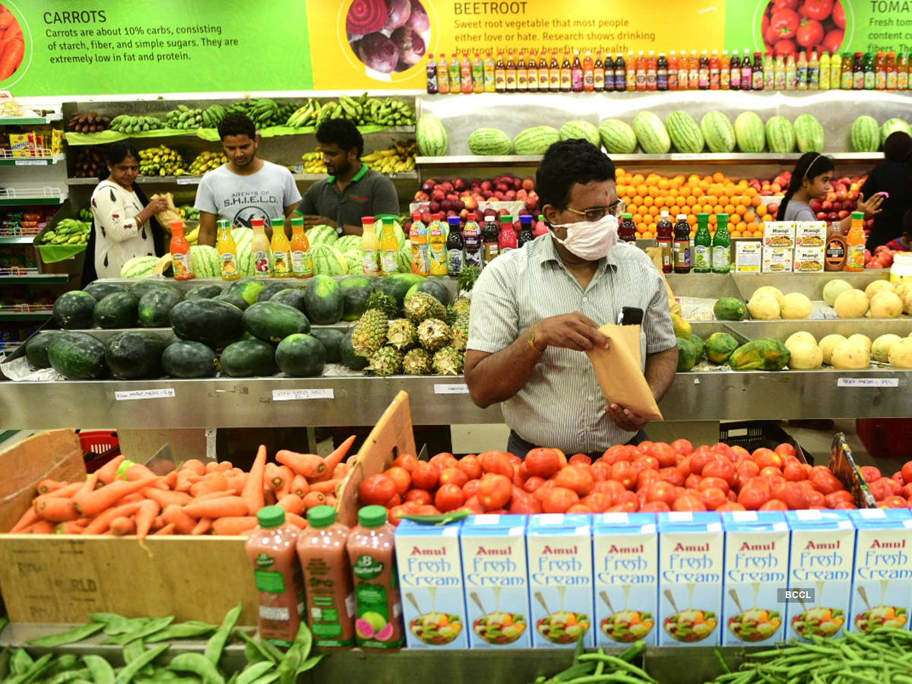
Notes:
Why we will thrive during a pandemic:
While over 22 million people have filed for unemployment in the last 4 weeks, my social supermarket will be considered an essential business and needed by the public!
During this pandemic and for a length of time after it ends, our memberships will be open to anyone- no matter previous income level. We will stick together during this time!

Slide 11

Notes:
Add-on features for the store would included pop up farmers markets, an exchange program for hours worked for groceries/”credit” at our store which is available to customers,
Of all essential frontline workers, grocery workers are among the least protected and lowest paid. So I would during this time induce a hazzard pay, we are an essential business, provide proper protections-- employees are on the frontlines !!!!
At The Social Grocer- We must fight for immediate solutions that prioritize strong health and safety standards, wage protections, paid leave, and unemployment insurance to protect frontline workers and all of our workers affected by this public health crisis.
If finanially we can not afford this-- now is the time to Apply for the small business loans to cover this problem

Slide 12
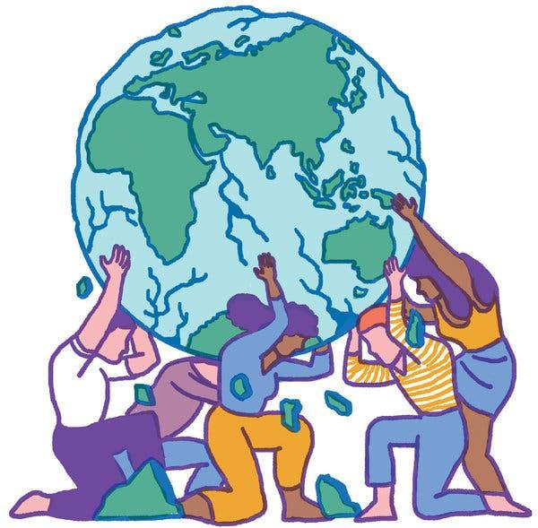
Notes:
WHy does all this matter? --- why a SSM matteres!!!! Food waste and food scarcity
A reminder of the bigger picture of The Social Grocer-- it is a win-win-win because it gives a home to food that would otherwise be thrown away, it helps people in need (whatever reason that may be), and it takes the burden off the non-profit organizations by creating a sustainable revenue to keep services going!!!!

Slide 13

Notes:
A big thank you to our previous investors!!!!
Almost 900,000$
United as One (tatiana), Veteran Fast-App (Kate), & Green Breeze (Matthew)!!!

Slide 14
Notes:
ENDING REMARKS-
Well thank you guys for your attention! I know this isn’t fun.
But thank you! And I hope to see some of you invest in The Social Grocer!!!

